Slide 1
Why?
Part 1
Why we do not have
a church kitchen
Notes:
Scripture reading: Acts 2:42-47

Slide 2

So why is a church kitchen such a big deal?
It distorts the work of the church
  from spiritual to carnal
It distorts the meaning of “fellowship”
It seeks to draw men with a carnal appeal rather than the cross
There is no Biblical authority

Slide 3
So why is a church carnival such a big deal?
It distorts the work of the church
  from spiritual to carnal
It distorts the meaning of “fellowship”
It seeks to draw men with a carnal appeal rather than the cross
There is no Biblical authority

Slide 4
So why is a church hospital such a big deal?
It distorts the work of the church
  from spiritual to carnal
It distorts the meaning of “fellowship”
It seeks to draw men with a carnal appeal rather than the cross
There is no Biblical authority

Slide 5
So why is a church gym such a big deal?
It distorts the work of the church
  from spiritual to carnal
It distorts the meaning of “fellowship”
It seeks to draw men with a carnal appeal rather than the cross
There is no Biblical authority

Slide 6
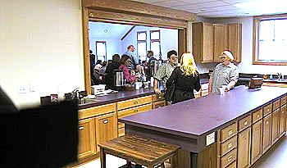
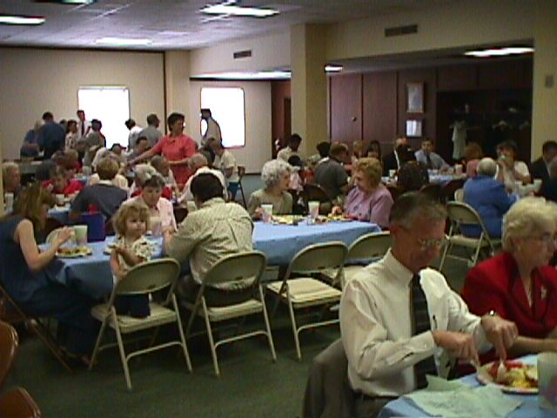
The Use of a
Church
Kitchen
Not Talking About:
A place to prepare LS
Place to wash LS trays
A place for taking care
of needy saints
Are Talking About:
Church providing a
place for meals for
SOCIAL &
RECREATIONAL
PURPOSES.
Fellowship halls
Family Life Centers
Multi-Purpose Blds

Slide 7

Eating In The Building
The Issue:
Was Not:
Is the bld. sacred?
Can one eat inside
the Building?
Can one eat on
church property?
Was & Is:
Can the church
sponsor a common
meal for social
and recreational
purposes?

Slide 8
Why we do not have
a church kitchen
I. No Bible Authority For it

Slide 9
How To Determine What Is
Authorized
Acts 15
Circumcision
Illustracted
Lord’s Supper
Command/
Direct
Statement
Approved
Example
Necessary
Inference
Observance
1 Cor. 11:23-24
Time of Ob.
Acts 20:7
Frequency
Acts 20:7
vv. 13-21
v. 12
vv. 7-11

Slide 10
There Is No
}
Command
To authorize the church to arrange / support a common meal for social and recreational purposes.
Example
Necessary
Inference
If there is, where is the passage?

Slide 11
Aids Are Authorized Within The Command
Command | Aid
Eat Bread – 1 Cor. 11 | Table, plates …
Baptize – Matt. 28:19 | Baptistry, heater
Build an ark – Gen. 6:14 | Tools
Sing – Eph. 5:19 | Books, Tuner
Contribute – 1 Cor. 16 | Basket, Account
Provide meals for social & rec. purposes (???) | Kitchen, Fellowship Hall
Question:
Where is the
Authority?

Slide 12
One might respond…
“We have restrooms, sinks, water fountains, and cry rooms, why not a kitchen?”
These are not provided for entertainment
These are expedient accommodations for the command to assemble (Heb. 10:25)
  They fall in with song books for singing, lights for seeing, heat for winter, and air conditioning for summer
  Would it make sense to advertise?
    “Join in fellowship at the church restroom!”
    “Join us at 7:30 for a ‘water drinking’ at the church fountain!”

Slide 13
Ian Coker
“But I could imagine a scenario where a kitchen of some substance might be very important to the work of a congregation - eg. emergency help in natural disasters, or in depressed areas where members practice benevolence toward large numbers of people continually. In a similar vein, medical facilities can be of great importance to a church in, say, a third-world country, whereas with our medical infrastructure we see no need.
I could even imagine a basketball hoop in the church parking area could be a valuable tool if the church was in a ghetto-type area that lacked space for neighbourhood children to play on” (http://www.churchofchrist.com.au/Lectures/Issues/Kitchen.htm)

Slide 14
Mr. Coker’s imagination serves as his authority
To build church kitchens in natural disaster areas and depressed areas where members practice benevolence
  Which is it?
    The church or individuals? He mixes church duties with individual liberties
    An act of benevolence to those in the world or fellowship among saints?
      He cannot make up his mind and blends them together
To build medical facilities in third world countries
To build basketball courts for the “ghetto-type areas” of the country
Notes:
No, David was not longing for basketball courts, “My soul longs, yes, even faints For the courts of the LORD; My heart and my flesh cry out for the living God” (Ps. 84:2)

Slide 15
Mr. Coker Imagined Some Scriptures Were His Support
“My point is this, in case you haven’t already seen it: in justifying a church building we have already answered the question about kitchens and fellowship areas! All we have to do is find out whether the Bible teaches fellowship is a required church activity. I don’t want to beg your intelligence and knowledge by proving that God intended fellowship to be a part of congregational life since the beginning in Jerusalem (Acts 2:42,46)”

Slide 16
  Acts 2:42, “And they continued steadfastly in the apostles’ doctrine and fellowship, in the breaking of bread, and in prayers.”
Does Acts 2:42 authorize a church kitchen?
  Coker says “yes!” He defines “fellowship” as “eating together” and then shows a passage that teaches fellowship is a part of the work of the church since the beginning
  I could authorize a “church arcade” by defining fellowship as playing video games!
    “fellowship” (2:42) is imagined to mean eating common meals together…does it make sense?
    “And they continued steadfastly in the apostles’ doctrine and eating common meals together, in the breaking of bread, and in prayers?” (man’s perverted text)

Slide 17
  Acts 2:42, “And they continued steadfastly in the apostles’ doctrine and fellowship, in the breaking of bread, and in prayers.”
“Fellowship” in Acts 2:42 DOES NOT authorize a church kitchen?
  CONTEXT…“fellowship” here means sharing in a gift or contribution (2:44, 45; 4:34-37)
    They had the same standard –apostolic doctrine
    They had the same faith—all who believed
    They had the same care—sold possessions and goods to provide for any believer who had need (2:44, 45)
      Not, “they constructed a large kitchen and hall so that they could eat fried chicken and coleslaw together”

Slide 18
  Acts 2:42, “And they continued steadfastly in the apostles’ doctrine and fellowship, in the breaking of bread, and in prayers.”
Does “breaking of bread” in Acts 2:42 authorize a church kitchen?
  The “breaking of bread” is distinguished from “fellowship” and “prayers”
    It does not mean there is no fellowship in the breaking of bread
    It does not mean there are no prayers connected with the breaking of bread
    It does mean that it is distinguished from the others as its own separate act
    It refers to the “Lord’s Supper” (1 Cor. 11:20)
      instituted on Passover Luke 22:15-20
      Christ manifested himself in breaking bread on the first day of the week (Lk. 24:1, 13, 27-35)

Slide 19
  Acts 2:46, “So continuing daily with one accord in the temple, and breaking bread from house to house, they ate their food with gladness and simplicity of heart”
Does Acts 2:46 authorize a church kitchen?
  No mention of such
  No example of such
  No implication of such

Slide 20
  Acts 2:46, “So continuing daily with one accord in the temple, and breaking bread from house to house, they ate their food with gladness and simplicity of heart”
Does Acts 2:46 authorize a church kitchen?
  They continued daily with one accord in the temple—for worship
    Suitable for 3000 people to assemble (2:41)
  Breaking bread was from “house to house”
    Distinct from the bread in 2:42, viz., “their food” versus “Lord’s Supper” (1 Cor. 11:20)
    Shows there was not a place built by the church to house such a work to eat “their food”
    The very passage proponents use in support of a church kitchen and an “eating hall” actually denies both!

Slide 21
If:
“They continued steadfastly in…fellowship”
(Acts 2:42)
CHURCH KITCHEN
Then:
“This punishment which was inflicted by the majority”
(2 Cor. 2:6)
CHURCH PRISON

Slide 22
Mr. Coker Imagined Some More Support
“There is no great doctrinal stress on this because it is a ‘given’ that fellowship, whether in Old testament or New, in eastern or western culture, includes the idea of sharing a meal together. 2 Peter 2:13 and Jude 12 are obvious references to this practice. It is a ludicrous position that says Christians, who enjoy the finest and closest fellowship in the world, cannot eat together.”

Slide 23
“and will receive the wages of unrighteousness, as those who count it pleasure to carouse in the daytime. They are spots and blemishes, carousing in their own deceptions while they feast with you” (2 Pet. 2:13)
“while they feast with you”
  Assumption ≠ proof
    Passage does not define what kind of feast
    a spiritual feast as in preaching; a memorial feast as in the Lord’s Supper, a common feast from house to house; etc.
  Why not assume there were “church beds” seeing that some had eyes full of adultery at these feasts (2 Pet. 2:14)!

Slide 24
“These are spots in your love feasts, while they feast with you without fear, serving only themselves. They are clouds without water, carried about by the winds; late autumn trees without fruit, twice dead, pulled up by the roots” (Jude 12)
  Assumption ≠ proof
  “spots” are figurative; “clouds” are figurative; “winds” are figurative; “late autumn trees” are figurative; “without fruit” is figurative; “twice dead” is figurative; “roots” are figurative
  Why should I not also think the “love feast” is figurative for worship or specifically the Lord’s Supper?
  Should we promote “church orchards” with our “church kitchens?”

Slide 25
  “Love feasts” ( Jude v. 12, Gk. agape)
    God demonstrated His “agape” for us when Christ died for us and we commemorate that in the Lord’s Supper (Rom. 5:8)
      “Greater love has no one than this, than to lay down one’s life for his friends” (Jn. 15:13)
      “For as often as you eat this bread and drink this cup, you proclaim the Lord’s death till He comes” (1 Cor. 11:26)
AGAPE

Slide 26
  “Love feasts” ( Jude v. 12, Gk. agape)
    We abide in Christ’s “agape” when we keep His commandments (Jn. 15:9, 10)
      The purpose of the commandment is “agape” from a pure heart (1 Tim. 1:5)
      Giving all goods to feed the poor could still lack “agape”
        “Agape” is at the heart of the action and within the right or sphere to act—truth (1 Cor. 13:3, 6)
      Truth is to be preached in “agape” and “agape” rejoices in truth (Eph. 4:15; 1 Cor. 13:6)
      Church kitchens and eating halls cannot be authorized in the word (truth) and therefore cannot be advocated for or sponsored from “agape!”
      Those who perish will perish because they did not receive the “agape” of the truth (2 Thess. 2:10)
AGAPE

Slide 27
There is no proof to authorize the church to build kitchens or sponsor recreational activities
“What! Do you not have houses to eat and drink in? Or do you despise the church of God and shame those who have nothing? What shall I say to you? Shall I praise you in this? I do not praise you” (1 Cor. 11:22)
We have more to say in “Part 2” regarding the nature of the work of the church, individual liberties versus congregational; etc.

